Slide 1


Final Project Ideas Pradeep Yarlagadda Oct 17, 2017
Notes:
Gilead: Global bio-pharmaceutical company headquartered in Foster City with primary medication in HIV, Liver, and Oncology TAs
Approx. 9,000 employees in R&D, Commercial, and G&A functions

Slide 2




Predicting Quality of Hire
Candidates (100)
Past Screening (20)
Hire
Problem Statement
To predict if a candidate will be a successful hire
Data
Employee performance, tenure, and promotions (Outcome: QoH index)
Hired & Open reqs (skill-set, experience, level), recruitment process
Applicant tracking and CV data (text data)
Source: Gilead Internal HR Systems (Oracle DW, OBIEE, Workday)
Hypothesis
Quality of hire can be predicted by skill-set match, relevant education, previous work experience, and other demographic data
Notes:
Time to hire and Onboarding experience
Tenure (duration analysis)
On the job performance
QoH index = (Post-Hire Performance + Candidate Satisfaction + Retention) / 3
Hiring Manager Satisfaction
Eventually layer-in network analysis

Slide 3
Build Leadership Pipeline
Problem Statement
To spot leaders early in their careers and invest on honing the right skills
Data
Employee team size, diversity, and demographics
Career progression and performance evaluation of M&L competencies
Upward feedback scores and comments (text data)
Source: Gilead Internal HR Systems (Oracle DW, OBIEE, Workday)
Hypothesis
There are factors that indicate good managerial skills and leadership capabilities.
Follow-up: Internal talent can be redeployed for higher impact with minimal disruption to business
Notes:
High performing team with multiple leaders can create flight risk
Deploy leaders in areas that require guidance to execute
Good managers can be identified by 4Cs – Conflict, Communication, Confidence, and Conscience
Internal rotation can be leveraged as a leadership opportunity to test bench strength and build the muscle
Quantify managing a resource as % of productivity

Slide 4
Could a machine do your job?
Problem Statement
Should the predictable portion of job be replaced with technology to improve overall productivity?
Data
Employee job profiles and compensation data
Classification of job duties or goals by activity and function (clustering)
Technical Feasibility: costs to automate vs. labor, regulations, benefits beyond substitution
Source: Gilead Internal HR Systems (Oracle DW, OBIEE, Workday) and External benchmarking
Hypothesis
About 30% of employee job duties can be automated
Notes:
Removing administrative overhead can free-up time for core competencies
Automation guarantees quality: improves insights for data-driven organizations

Slide 5
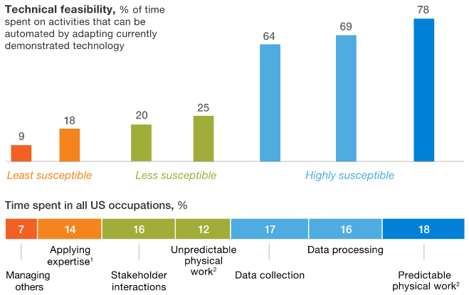
Appendix – Technical Feasibility
Reference: "Where machines could replace humans—and where they can’t (yet)" By Michael Chui, James Manyika, and Mehdi Miremadi
Data from US Bureau of Labor Statistics using 2,000-plus work activities for more than 800 occupations
Notes:
About 50% of jobs are highly susceptible to automation by adapting current technology
With advancement in NLP technologies, these numbers could go even higher

Slide 6
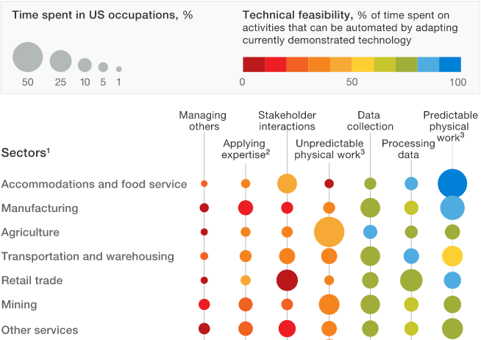
Appendix – Automation Heatmap
Reference: "Where machines could replace humans—and where they can’t (yet)" By Michael Chui, James Manyika, and Mehdi Miremadi
Data from US Bureau of Labor Statistics using 2,000-plus work activities for more than 800 occupations
Notes:
Lowest in education sector (27%)
Healthcare (36%)

